Slide 1
Coding Process
Instructor << >>

Slide 2
Agenda
Coding Process
Coding Convention
Code Review Process
Common Defects & Practices

Slide 3
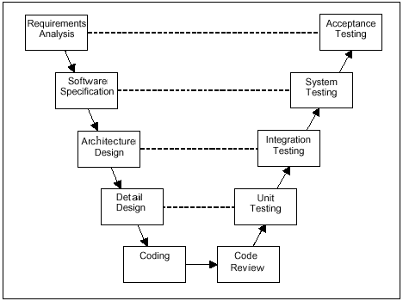
Coding Process Where the Coding is?

Slide 4
Coding Process Coding Workflow

Slide 5
Coding Process Code Planning
Purpose: To plan and prepare for coding
Steps:
Study design documents
Define and prepare resources and infrastructure for coding, unit test and integration, if necessary.
Create coding plan including targets, scope, required deliverables and acceptance criteria,
task and schedule, responsibilities
Review and obtain agreement on coding plan
Develop/customize coding convention
Review & conduct training on coding convention
Verify tools support for coding (if any)

Slide 6
Coding Process Coding Library Modules
Purpose: To build, construct and/or develop library modules
Steps:
Create detail design for library modules
Code library modules
Review code of library modules
Fix defects of library modules
Summarize related documents

Slide 7
Coding Process Coding Functional Modules
Purpose: To build, construct and/or develop functional modules
Steps:
Create detail design for modules and program units, if required in design documents
Code modules and program units
Review code
Fix defects for modules and program units
Summarize and submit result to Team Lead

Slide 8
Coding Process Integrate Software Modules
Purpose: assemble the software package from the software modules, ensure that the software package, as integrated and functions properly
Steps:
Create integration plan (if needed)
Integrate modules
Evaluate integration results, conduct cause analysis, raise change request (if needed)
Review and approve results of integration

Slide 9
Coding Process Create System Description
Purpose: To develop System Description /User Manual documents that support in software operation
Steps:
Make overview on system
Describe sub-systems and main functions including system structure scheme, flow charts, system interfaces, data flows
Describe system requirements including support data, memory capability, CPU and I/O requirements, storage capability, data for internal and external interfaces
Describe software structure including library of source codes (for system, sub-systems, objects) library of executive and supporting programs
Develop User Manual
Review and approve System Description/User Manual

Slide 10
Coding Process Deliver & Summarize
Purpose: To deliver software package
Steps:
Review, do final inspection and summarize software products including documents
Deliver to test team
Create coding summary report
Maintain documents, records

Slide 11
Coding Convention Introduction
Be specific to each programming language
Recommend programming style, practices, and methods for each aspect of a piece program
Common conventions may cover the following areas:
file organization,
naming conventions
indentation, white space,
comments, declarations, statements,
programming practices, principles, rules of thumb,
Etc.

Slide 12
Coding Convention Importance
Code conventions are important to programmers for a number of reasons:
80% lifetime software cost is for maintenance
People maintain the software may be changed
Following coding convention strictly helps:
Improve the readability of the software
Allowing engineers to understand new code more quickly and thoroughly

Slide 13
Coding Convention Some Common Standards 1/2
Tab and Indent
4 spaces should be used as the unit of indentation
Tab characters should be avoided
Line Length: avoid lines longer than 80 or 120 characters
Wrapping Lines: When an expression will not fit on a single line, break it according to below principles:
Break after a comma.
Break after a logical operator.
Break before an operator.
Prefer higher-level breaks to lower-level breaks
…
Comments: beginning, block, single-line, trailing, …
Number of declarations per line: same types, different types,..

Slide 14
Coding Convention Some Common Standards 2/2
Blank Lines improve readability by setting off sections of code that are logically related
Two blank lines should always be used:
Between sections of a source file
Between class and interface definitions
One blank line should always be used:
Between methods
Between the local variables in a method and its first statement
Before a block or single-line comment
Between logical sections inside a method
Blank spaces should be used in the following circumstances
A keyword followed by a parenthesis should be separated by a space
A blank space should appear after commas in argument lists
All binary operators except . should be separated from their operands by spaces

Slide 15
Coding Convention Naming Conventions
General naming rules:
Should be functionally meaningful, & indicate identifier’s purpose
Use terminology applicable to the domain
Identifiers must be as short as possible (<=20 characters)
Avoid names that are similar or differ only in case
Abbreviations in names should be avoided, etc.
Use a noun or noun phrase to name a class or code module
Variables names must start with lowercase
Constants: named in uppercase letters, might have underscore
Method names must start with lowercase letter, usually use “active verb” as the first word of method name
Instance /object names follow rules of variable names

Slide 16


